Slide 1
COMPARATIVE AD ANALYSIS

Slide 2
EXECUTIVE SUMMARY
OVERVIEW OF FINDINGS
33.9% increase in clicks from Current Ad (2.82% CTR) to Ad A (4.1% CTR)
Ad A should replace the Current Ad
Number of exercises completed did not increase number of clicks
Number of achievements did not increase number of clicks
METHODOLOGY OF ANALYSIS
The two data frames, Current Ad and Ad A, were pulled in separately and statistical analysis was performed on both including click-through rates for each ad and the percentage increase from the Current Ad to Ad A.
Next, the two data frames were unioned into Allads and any outliers were removed. Following this, a T-test was performed on the number of clicks for each ad to determine statistical significance.
The p-value outputted by the T-test proved that there is statistical significance between the number of clicks for both ads.

Slide 3
BACKGROUND
GOALS
Increase click-through rate
Increase awareness of Ready
Determine which ad was more effective in achieving these goals
Determi
TOOLS
Jupyter
Sqlite
Python and the following Python libraries:
Numpy
Scipy
Matplotlib
Seaborn
Pandas
Determi
STATISTICAL ANALYSIS
Ad A was designed to address the feedback provided in the survey with the intent of increasing Ready awareness and transparency regarding pricing and Ready features by changing the ad style, content and position.
Given the independent variable is the ads and the dependent variable is the number of clicks, I first tested the efficacy of Ad A by running a standard T-test on the number of clicks for both Ad A and the Current Ad.
I hypothesized that given the changes Ad A would have a higher number of clicks.

Slide 4
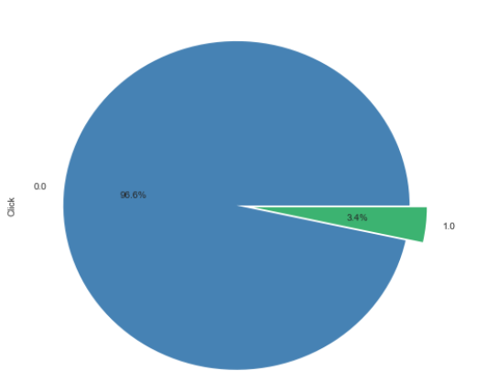
TOTAL CLICKS FOR BOTH ADS
Total Number of Impressions 27,267
Total Number of Clicks
931

Slide 5
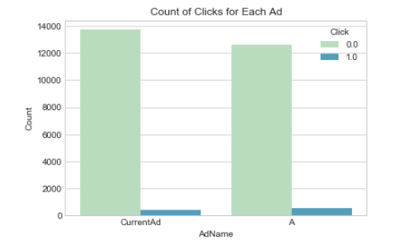
HOW EFFECTIVE WAS AD A?
CURRENT AD
Number of Impressions
14,125
Number of Clicks
398
AD A
Number of Impressions
13,143
Number of Clicks
533
2.8% CTR
4.1% CTR
33.9% INCREASE IN CLICKS

Slide 6
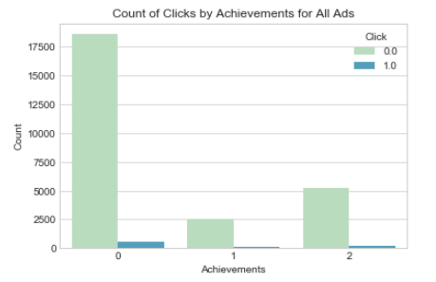
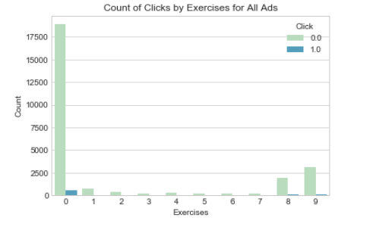
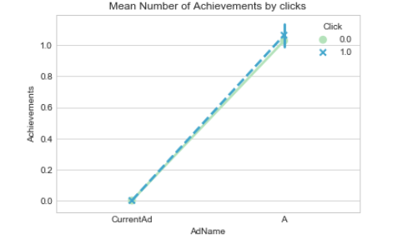
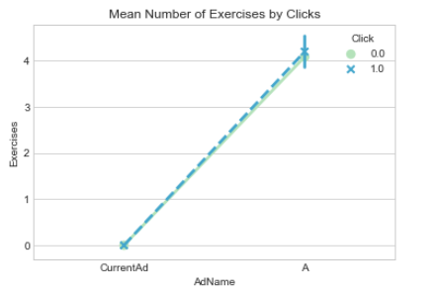
EXERCISES & ACHIEVEMENTS DON’T INCREASE CLICKS

Slide 7
CONCLUSION
Ad A’s content and position on the signup page was effective in encouraging users to click. Ad A increased the number of clicks from 2.8% to 4.1% with a 33.9% increase in clicks. It is advised that Ad A replace the Current Ad.

